Slide 1
Learning Processes
091601
  by Huafu Chen
SLST
UESTC, China

Slide 2
Learning
Learning is a process by which free parameters of NN are adapted thru stimulation from environment
Sequence of Events ( three steps)
  stimulated by an environment
  undergoes changes in its free parameters
  responds in a new way to the environment

Slide 3
Learning
Learning Algorithm
  It is the prescribed steps of process to make a system learn
    ways to adjust synaptic weight of a neuron
  No unique learning algorithms - kit of tools(工具包)
  The Chapter covers
five learning rules, learning paradigms（范例）, issues of learning (task、memory、adaptation）
  probabilistic and statistical aspect of learning

Slide 4
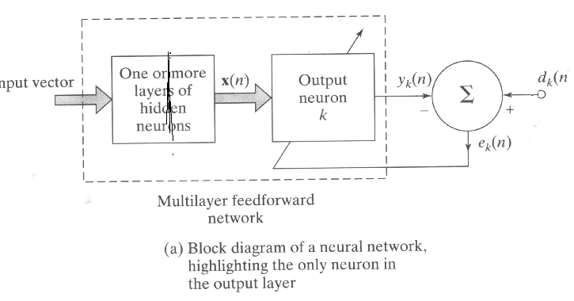
Error Correction Learning
five learning rules-1
Idea: Error and correction (知错就改）
Ilustration( Figure 2.1 (a) , page 52)

Slide 5
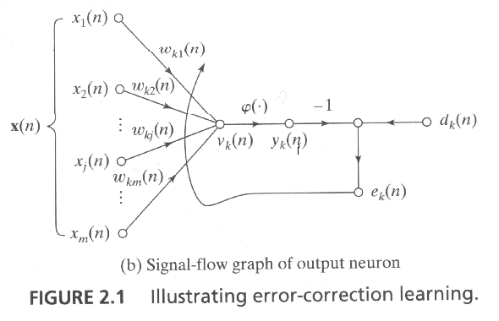
Error Correction Learning
five learning rules-1
Idea: Error and correction (知错就改）
Ilustration(Figure 2.1 (b), page 52)

Slide 6
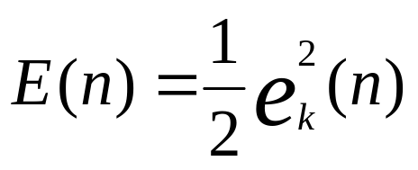
five learning rules-1
Error Correction Learning
Mathematical Description
1) Error signal definition: e_{k}(n)
  e_{k}(n) = d_{k}(n) - y_{k}(n)
  where n denotes time step, kth neuron
2) Cost function definition: E(n) error energy
-- instantaneous (step n) value of error energy

Slide 7
five learning rules-1
Error Correction Learning
Mathematical Description
How to modify the synaptic weight ?
Error signal activates a control mechanism for corrective adjustment of synaptic weights
step-by-step adjustment until
  system reaches steady state; synaptic weights are stabilized

Slide 8
Error Correction Learning
five learning rules-1
Mathematical Description
Delta rule or Widrow-Hoff rule
in honour of its originators (Widrow and Hoff, 1960)
Δw_{kj}(n) = ηe_{k}(n)x_{j}(n) (2.3)
w_{kj} : weight of signal flow from j to k;
η : rate of learning; learning-rate parameter
w_{kj}(n+1) = w_{kj}(n) + Δw_{kj}(n)
w_{kj}(n) = Z⁻¹[w_{kj}(n+1) ]
Z⁻¹ is unit-delay operator

Slide 9
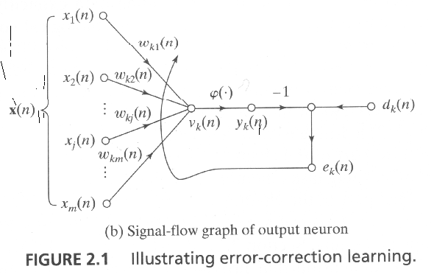
Error Correction Learning
five learning rules-1
Mathematical Description
w_{kj}(n+1) = w_{kj}(n) + Δw_{kj}(n) = w_{kj}(n) + ηe_{k}(n)x_{j}(n)
e_{k}(n) = d_{k}(n) - y_{k}(n)
Discussion:
1) adjustment is proportioned to the product of error signal and input signal
2) (Figure 2.1)
(1) X_{j}>0, Δw_{kj} >0;
(2) X_{j}>0, Δw_{kj} <0.
( Similar for X_{j}<0).

Slide 10
Error Correction Learning
five learning rules-1
Mathematical Description
3) Error-correction learning is local
4) The learning rate η determines the stability or convergence
5）Just for visible neuron
It requires that the error signal is directly measurable. In other word, neuron k is visible to the outside world. For example, a neuron of the output layer of a feedforward single/multilayer NN, or other special NN.
6) Error-correction learning is rooted in optimum filtering.

Slide 11
Memory-based Learning
five learning rules-2
Classfication by “ Local neighbourhood” :
“nearest neighbor” or “k- nearest neighbor””
Memory as the base:
all (or most) of the past experiences are explicitly stored in a large memory of correctly classified input-output examples
{(x_{i} , d_{i}), (I=1,…,N).
Where x_{i} denotes an input vector and d_{i} denotes the corresponding desired response.
Learning/classification of a test vector x_{test} (not seen before):
the algorithm responds by retriving and analyzing the training data in a “ local neighbourhood” of x_{test}.

Slide 12
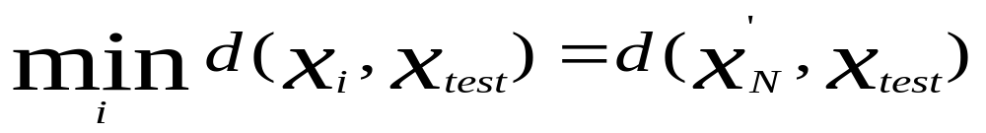
Memory-based Learning
five learning rules-2
Essential Ingredient（因素）
Criterion used for defining local neighborhood of the test vector x_{test.}
  Learning rule applied to the training examples in the local neighborhood of x_{test.}
  Nearest Neighbor Rule (NNR)
  the vector x’_{N} ∈ {x₁, x₂, …,x_{N} } is the nearest neighbor of x_{est} if
  The class associated with the minimum distnce, that is vector x’_{N} , is reported as the classification of x_{test}
  （ x_{test} 与谁的距离最近，那么它们就属于同一类; “近墨者黑”）

Slide 13
Nearest Neighbor Rule
five learning rules-2
Cover and Hart （1967）:
studied NNR as the classification tool for pattern classification
They assumed:
1)Examples are independent and identically distributed (iid).
  2)The sample size N is infinitely large
Notes:
Examples are independent and identically distributed (iid) according to the joint probability distribution of the example (x,d).

Slide 14
Nearest Neighbor Rule
  They concluded:
  The probability of classification error (NNR) < 2 * Bayes probability of error (Bayesian rule)
  ---Half of the information is contained in the Nearest Neighbor
  ( Bayes probability of error is the minimum probability of error over all decision rules)

Slide 15
K-nearest Neighbor Rule
five learning rules-2
  1) It is a variant of NNR
  2) It proceeds as follows:
  i) Select k-nearest neighbors of x_{test} for an integer k.
  ii)Use a majority vote to make the classification.
Notes:
Classified by the nearest neighbour; by K-nearest Neighbours vote and by analytic result of Radial-basis function network (Chapter 5).

Slide 16
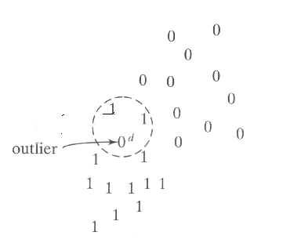
Example （Figure 2.2 ，page 55)
  It acts like averaging device discriminate against (歧视）outlier
Summary: Classified by the nearest neighbour; by K-nearest Neighbours vote
Area lying inside the dashed circle includes two points pertaining to class 1 and an outlier from class 0. The point d corresponds to the test vector xtest. With k=3, the k-nearest neighbor classifier assigns class 1 to point d even though it lies closest to the outlier.

Slide 17
Hebbian Learning
five learning rules-3
Background
Hebb’s postulate（假定） of learning
Hebb’s book “The organization of Behavior(1949, p.62)”:
When an axon of cell A is near enough to excite a cell B and repeatedly or persistently takes part in firing it, some growth process or metabolic changes take place in one or both cells such that A’s efficiency as one of the cells firing B, is increased.
Notes:
Hebb’s postulate（假定） of learning is the oldest and most famous of all learning rules.

Slide 18
Hebbian Learning
This statement may be expanded and rephrased as a two-part rule:
If two neurons of a connection are activated
  simultaneously (synchronously), then its strength is increased;
  asynchronously, then the strength is weakened or eliminated.

Slide 19
five learning rules-3
General Mathematical model：
Δw_{kj}(n) = F(y_{k}(n), x_{j}(n))
The formula admits many forms, all of which qualify as Hebbian.
Hebb’s hypothesis：
Δw_{kj}(n) = ηy_{k}(n)x_{j}(n)， η-- rate of learning
  also called activity product rule

Slide 20
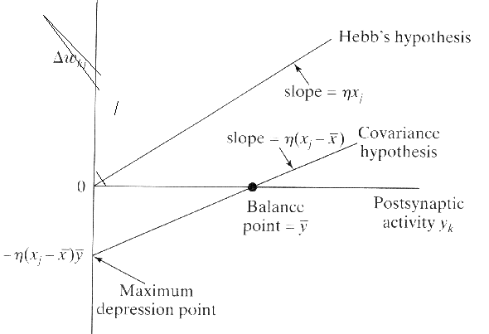
five learning rules-3
Discussion:
repeated application of x_{j} leads to exponential growth that finally drives the synaptic connection into saturation. At that point no information will be stored in the synapse and selectivity is lost.
Δw_{kj}(n) = ηy_{k}(n)x_{j}(n)
Notes:
Depression 降低，压低
repeated application of x_{j} leads to exponential growth that finally drives the synaptic connection into saturation. At that point no information will be stored in the synapse and selectivity is lost. (Figure 2.3 page 57)

Slide 21
Hebbian Learning
Covariance hypothesis
Δw_{kj}(n) = η(x_{j} - x)(y_{k} - y)
1. w_{kj} is enhanced if x_{j} > x and y_{k} > y
2. w_{kj} is depressed if (x_{j} > x and y_{k} < y ) or (x_{j} < x and y_{k} > y )
where x and y are time-average and this behavior may be regarded as a form of temporal competition between the incoming patterns.

Slide 22
Hebbian Learning
five learning rules-3
Discussion
Hebbian learning is found in Hippocampus
1) There is strong physiological evidence for Hebbian learning in hippocampus.
2) The hippocampus plays an important role in certain aspects of learning or memory.
3)This physiological evidence makes Hebbian Learning all the more appealing.

Slide 23
five learning rules-3
Hebbian Learning
Generalized Hebbian Learning
We may classify synaptic modifications as Hebbian, anti-Hebbian, and non-Hebbian.
Hebbian synapse:
increases(decreases) its strength with positively(negatively) correlated/(or uncorrelated) pre-synaptic and post-synaptic signals.

Slide 24
Hebbian Learning
Anti-Hebbian synapse:
Decreases (increases) its strength with positively (negatively) correlated (or uncorrelated) pre-synaptic and post-synaptic signals.
Both the above two synapses rely on a mechanism that is time – dependent, highly local, and strongly interactive in nature. In that sense, an anti-Hebbian synapse is still Hebbian in nature.
Non-Hebbian synapse:
does not involve a Hebbian mechanism of either kind.

Slide 25
Competitive Learning
five learning rules-4
Output neurons of NN compete to became active
Only single neuron is active at any one time
In a neural network based on Hebbian learning several output neurons may be active simultaneously,
in competitive learning only a single output neuron is active at any one time.
Find salient feature for pattern classification
Competitive learning highly suited to discover statistically salient features that may be used to classify a set of input patterns.

Slide 26
Competitive Learning
five learning rules-4
Three Basic Elements ( Rumelhart and Zipser, 1985)
  A set of neurons that are all the same except for some randomly distributed synaptic weights
    responds differently to a given set of input pattern
  A Limit on the strength of each neuron
  limit power of each neuron for justice

Slide 27
Competitive Learning
  A mechanism to compete to respond to a given input
    winner-takes-all
Neurons learn to respond specialized conditions (ensembles of similar patterns)
  become feature detectors

Slide 28
Competitive Learning
five learning rules-4
Architectural graph of a simple competitive learning neural network
Feedforward
Connections from
the source nodes
to the neurons
are excitatory
Lateral
connection ( )
is inhibitory
- lateral inhibition
layer of
Source nodes (Input)
Single layer of
output neurons

Slide 29
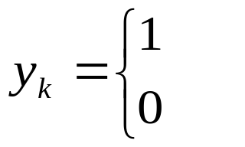
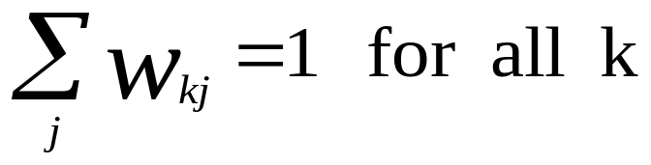
Competitive Learning
five learning rules-4
Mathematical model
Output signal ( Only one is active)
if v_{k} > v_{j} for all j, j ≠ k
otherwise
W_{kj} denotes the synaptic weight

Slide 30
Competitive Learning
Here suppose that each neuron is allotted（分配） a fixed amount of synaptic weight (I.e., all synaptic weights are positive), which is distributed among its input nodes.
A neuron then learns by shifting synaptic weights from its inactive to active input nodes.

Slide 31
Competitive Learning
five learning rules-4
Competitive Learning Rule
1) If neuron does not respond to a particular input, no learning takes place
If a particular neuron wins the competition, each input node of that neuron relinquishes (放弃）some proportion of its synaptic weight, and the weight relinquished is then distributed equally among the active input nodes.
2) Thus the neuron learns by shifting synaptic weights from its inactive to active input nodes.

Slide 32
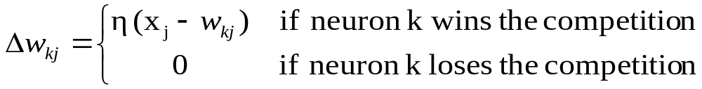
Competitive Learning
five learning rules-4
The methematical model
η : rate of learning; learning-rate parameter
The rule has the overall effect of moving the synaptic weight vector w_{k} of winning neuron k toward the input pattern x.

Slide 33
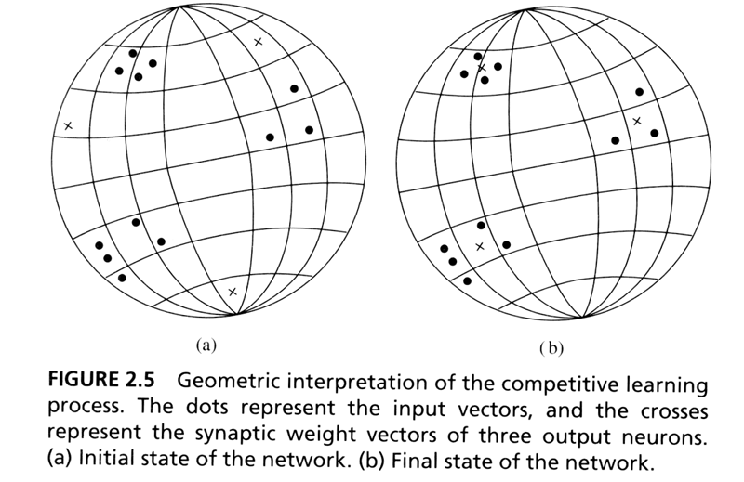
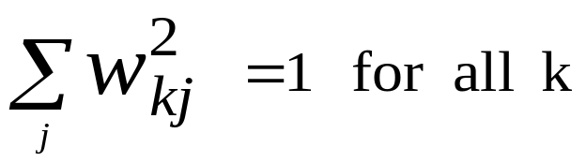
five learning rules-4
Geometric analogy of competitive learning
Assume both x and W are on the same N-D unit sphere.
perform clustering thru competitive learning
Notes:
N-D (dimensional)
Assume each input pattern x has constant Euclidean length,and both x and W are on the same N-D unit sphere.
perform clustering thru
competitive learning

Slide 34
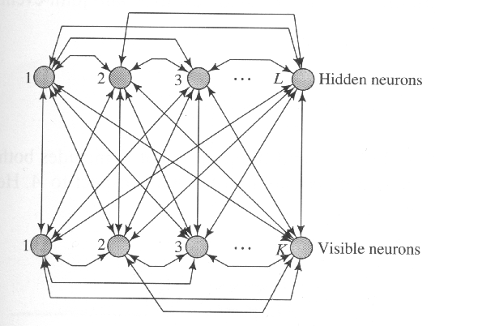
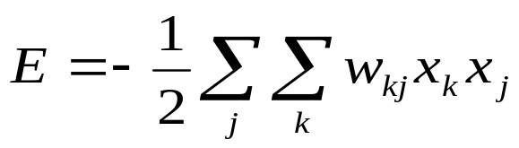
Boltzman Learning
five learning rules-5
Rooted from statistical mechanics
Boltzman Machine : NN on the basis of Boltzman learning
The neurons constitute a recurrent structure
  operate in binary manner: “on”: +1 and “off”: -1
  Visible neurons and hidden neurons
  energy function
  means no self feedback
j ≠ k
j ≠ k
Notes:
The neurons constitute a recurrent structure
( Fig.11.4 page 563)

Slide 35
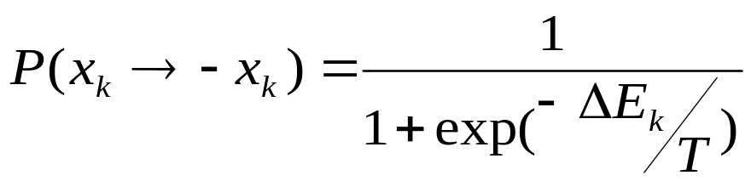
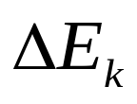
Boltzman Machine Operation
five learning rules-5
choosing a neuron at random, k, then flip the state of the neuron from state x_{k} to state -x_{k} with probability
  where is energy change resulting from such a flip
If this rule applied repeatedly, the machine reaches thermal equilibrium.

Slide 36
Boltzman Machine Operation
five learning rules-5
Visible and Hidden neurons:
The neurons of a Boltzmann machine partition into two functional groups, visible and hidden.
The visible neurons provide an interface between the network and the environment in which it operates,
the hidden neurons always operate freely.

Slide 37
Boltzman Machine Operation
two modes of operation:
Clamped condition : visible neurons are clamped onto specific states
  Free-running condition: all neurons are allowed to operate freely

Slide 38
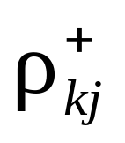
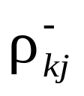
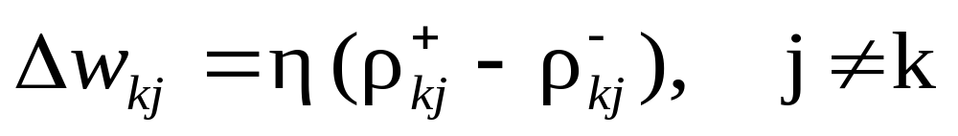
Boltzman Learning Rule
five learning rules-5
Let denote the correlation between the states of neurons j and k with its clamped condition
Let denote the correlation between the states of neurons j and k with its free-running condition
Boltzman Learning Rule (Hinton and Sejnowski 1986)
where η is a learning-rate
Notes:
Pjk 指 神经元处于 热平衡状态时的所有可能状态 下的结果。
两个步骤：
第1个步骤，visiable neuron 固定，然后 让它去演化； 同时，再不固定 让它去演化，如果Wkj很好了，两种情况下的神经元状态的统计规律就稳定了，学习好了。否则，就修改 Wkj， 直到 Wkj稳定，这样，visiable 和hidden神经元之间，在概率意义上的 关系，及服从的统计规律就确定了。
应用： 作用是pattern 不完整信息恢复的问题，将不完整的部分 加到visiable上，让它去演化，最后就可以通过演化得到，未知部分的信息。

Slide 39
five learning rules-5
Boltzman Learning Rule
Goal of Boltzman Learning is to maximize likelihood function
The primary goal of Boltzmann learning is to produce a neural network that correctly models input patterns according to a Boltzmann distribution.
Notes:
Goal of Boltzman Learning is to maximize likelihood function （chapter 11)
最大化似然函数，该函数是概率的对数，而这里的概率是处于某种状态的概率，实际就是找到一个能量最小的状态，被认为是一个稳定的状态，也是在clamped 时及其后能继续刻画environment/clamped 的状态。
The primary goal of Boltzmann learning is to produce a neural network that correctly models input patterns according to a Boltzmann distribution.
The Network can perform pattern completion (完成）. Specifically, when a partial information-bearing vector is clamped onto a subset of the visible neurons, the network performs completion on the remaining visible neurons, provided that it has learned the training distribution properly.
A particular set of synaptic weights is said to constitute a perfect model of the environmental structure if it leads to exactly the same probability distribution of the states of the visible units (when the network is running freely) as when these units are clamped by the environmental input vectors.

Slide 40
Boltzman Learning Rule
  The Network can perform pattern completion (完成）. Specifically, when a partial information-bearing vector is clamped onto a subset of the visible neurons, the network performs completion on the remaining visible neurons, provided that it has learned the training distribution properly.
  A particular set of synaptic weights is said to constitute a perfect model of the environmental structure if it leads to exactly the same probability distribution of the states of the visible units (when the network is running freely) as when these units are clamped by the environmental input vectors.

